Slide 1
Complex Social Systems: THE BEHAVIOURAL SINK
CSS Project’s Presentation - Alessio Melone, Henrique Ranieri, Francesco Rosano
Materials may not be shared without previous written permission of the authors and DH
Notes:
Welcome everyone, thanks for being here.
Today we are going to present the project that we developed during this semester.
First of all I'm alessio melone here we have…….cs students…….
The name of our group is Complex Social People and our project name is The Behavioral Sink.
What inspired our project was the work by american behavioral researcher John Calhoun, active from the 1950s.
Until that moment, the concerns about overpopulation were mainly focusing on the danger of scarcity of resources.
What Calhoun did was instead tried to delve deeper into the consequences that overpopulation could have on behavior —- so he started experimenting with a population of rats and writing about the observed behaviors.
The most complete paper about his observation is “Population Density and Social Pathology” (John B. Calhoun, 1962). He would later perform similar experiments on mice, from 1968 to 1972, observing similar behaviors, leading to its most famous experiment Universe25.

Slide 2
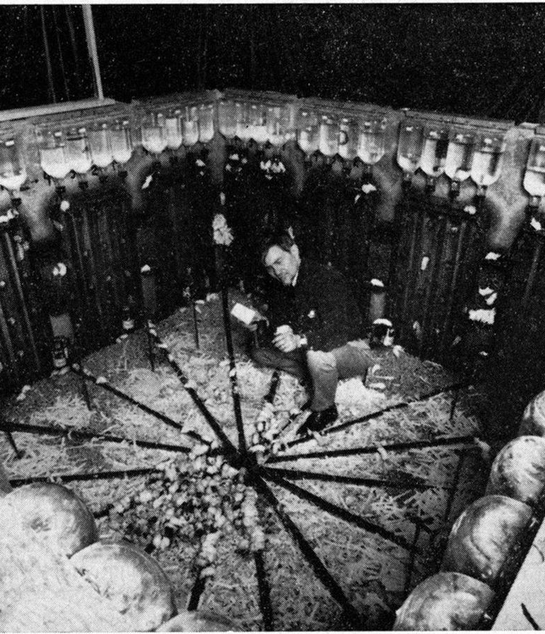
Universe 25 Experiment – John B. Calhoun, 1968
SETTING
Four mice couples at t₀
«Rat Utopia»:
Unlimited food and water
Protection from predators
Protection from weather
Protection from external diseases
Four pens in a «U» shape, one food dispenser each
Habitat built for 4000 mice
Only one scarce resourse: space
Notes:
beginning of the experiment, 4 mice couples were put in an “ideal” habitat, from the points of view of having:
Unlimited feeding resources
Protection from any external predator species
Protection from weather
Protection from external diseases
The habitat was divided by 4 square “rooms” or “pens” put together in a “U” shape, in the sense that the top left and top right were only connected respectively with the pens below, while the bottom pens were connected both between each other and the respective one above.
Overall, the environment was considered big enough to maintain a colony of up to 4000/5000 rats.

Slide 3
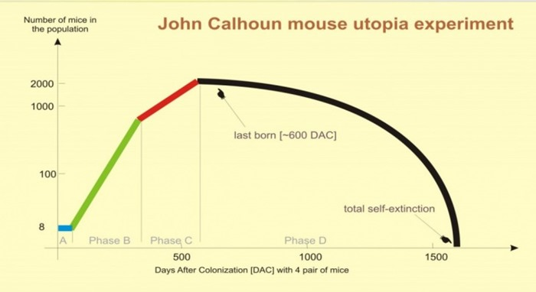
Universe 25 Experiment – John B. Calhoun, 1968
EMERGING BEHAVIOURS
Population peaked at 2200 mice (habitat for 4000)
Antisocial emerging behaviour:
Mothers abandoning «mothership», infant mortality
Cannibalism
Increased aggresivity
Sexual deviation
Self-isolation/«togetherness» necessity
Hyperactivity/laziness
Strict social hierarchy
High density lead to extinction
"BEHAVIOURAL SINK"
Too many complex emerging behaviours for a single model?
Notes:
SEVERAL EMERGING BEHAVIOURS>
Different peak (0.5)
Cannibalism
Sexual deviation
Need 4 togetherness
Aggression and social hierarchy
Low mothers function, infant mortality
Extinction

Slide 4
Universe 25 Experiment – John B. Calhoun, 1968
EMERGING BEHAVIOURS:
Population peaked at 2200 mice (habitat for 4000)
Antisocial emerging behaviour:
Mothers abandoning «mothership», infant mortality
Cannibalism
Increased aggresivity
Sexual deviation
Self-isolation/«togetherness» necessity
Hyperactivity/laziness
Strict social hierarchy
High density lead to extinction
"BEHAVIOURAL SINK"
OUR FOCUS:
Explored using 3 different agent-based models
Notes:
FIRST IDEA: SINGLE MODEL 4 ALL OF THEM
TOO MUCH COMPLEX!
3 MODELS TO UNDERLINE 3 DIFFERENT ASPECTS: TOGETHERNESS, HIERARCHY, INFANT DEADS/MATERN FUNCTIONS

Slide 5
Agenda
Models
1. Social Togetherness
2. Social Dominance and Fights
3. Infant Mortality and Mothership
Notes:
NOTES: LIMITED FROM TODAY’S PERSPECTIVE: SUBJECTIVE/BEHAVIOURAL
He said <<NOT NORMAL SCIENCE>>, but “OBSERVATION AND RECONSTRUCTION OF A PROCESS”
The literature did not evolve
Still INTERESTING
Our models are BEHAVIOURAL, NOT QUANTITATIVE
WE DO NOT HAVE TIME FOR ALL THE MODELS’ DETAILS: IF YOU WANNA MAKE ANY SUGGESTION/ASK ABOUT ANY CHOICES, FEEL FREE TO RAISE YOUR HANDS!

Slide 6
1. Social togetherness
Speaker: Henrique Ranieri

Slide 7
«Gradually the social aspect of the activity (of eating - editor’s note) became determinant: the rats would rarely eat except at hopper already in use by other animals.
…
the same pathological "togetherness"
tended to disrupt the ordered sequences
of activity involved in other vital modes
of behavior such as the courting of sex
partners, the building of nests and the
nursing and care of the young
Population Density and Social Pathology,
John B. Calhoun
https://gwern.net/doc/sociology/1962-calhoun.pdf

Slide 8

Social togetherness - Model
Focus: ’’Eating and other biological activities were thereby transformed into social activities in which the principal satisfaction was interaction with other rats.’’
Environment:
Four rooms with three bridges in between.
Agent behaviour:
Each rat tries to feed on a unique feeding window. Fixed size, random interval.
Prioritize adjancent rooms that meet their social togetherness necessities.
Social togetherness dynamically changes with the amount of rats each specific rat ate with. Eating with more rats conditions the rat to seek more social togetherness.
Generational dynamic: Rats die and new ones are born. Always constant population size.
https://gwern.net/doc/sociology/1962-calhoun.pdf

Slide 9
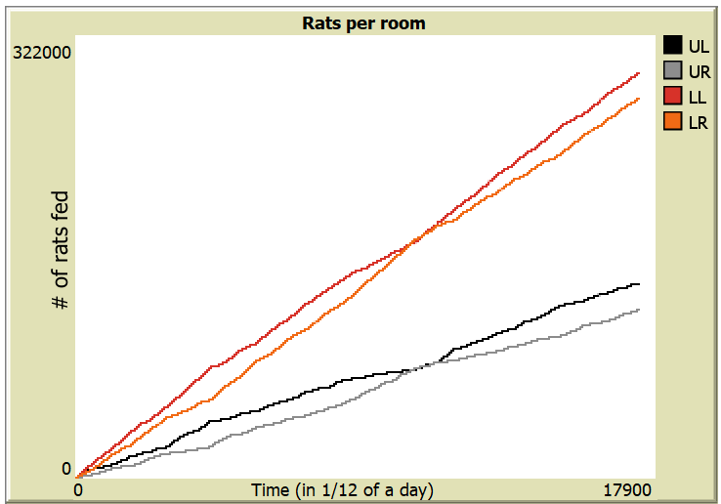
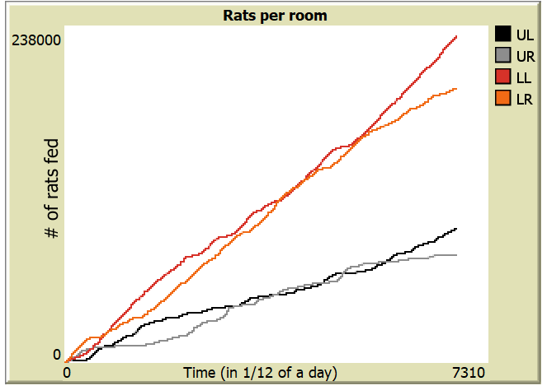
Social Togetherness - Population distribution
Lower rooms are consistently more populated.
Total room population emerges in vertical pairs.
Self-reinforcing social hub.

Slide 10
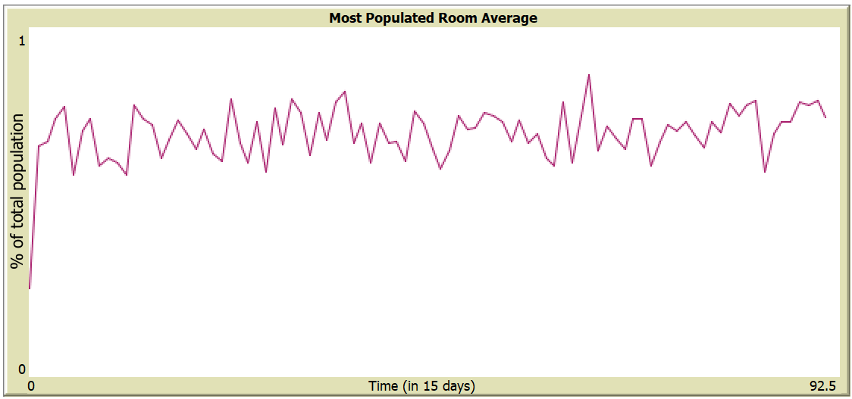
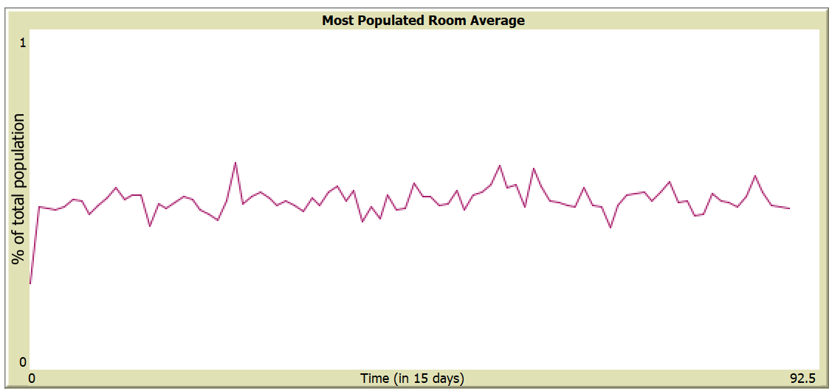
Social Togetherness - Beneficial enviroment conditions
The ease of environmental conditions allows social behaviours to thrive, leading to clustering.
More flexible feeding time.
More food available.
feeding windows of size 90% of the day
feeding windows of size 25% of the day

Slide 11
Social Togetherness - Additional observed behaviors
New generations have little influence over an established environment.
Conditioning coefficient values become irrelevant over time.

Slide 12
2. Social Dominance and Fights
Speaker: Alessio Melone

Slide 13
«… a dominant male was usually able to expel all other males and possess a harem of females.
The sex ratio approximated equality only in those groups that fell within the expected size range.
In the larger groups, on the other hand, there were many more males than females.
…
The more fights a male initiated and the
more fights he won, the more likely he
was to establish a position of dominance.
Population Density and Social Pathology,
John B. Calhoun
https://gwern.net/doc/sociology/1962-calhoun.pdf
Notes:
SOCIAL HIERARCHY CORRELATED TO FIGHTS
DOMINANCE AFFECTED THE SEX DISTRIBUTIONS IN PENS

Slide 14
Social dominance and fights – Moving
Seeking Food:
• Dominant Males: Claim and hover around a dispenser.
• Non-Dominant Males: Avoid dispensers near dominant males.
• Females: Go to the nearest dispenser.
Seeking Mates: appx. 5 attempts per lifespan.
• Dominant Males: Avoid mating if stronger males are nearby.
• Non-Dominant Males: Avoid females near dominant males.
Random Movement: Bias towards the center when idle.
Notes:
INIT
- PATCHES AT CORNERS
- MICE RANDOMLY DISTRIBUTED
MOVEMENT
SEEKING FOOD – MICE MOVE TOWARDS DISPENSERS WHEN HUNGRY (ENERGY OR INTERVAL)
Dominant Males: Claim a dispenser and hover around it.
Non-Dominant Males: Avoid dispensers near dominant males if possible.
Females: Always go to the nearest dispenser.
SEEKING MATES - AT REGULAR INTERVALS, MALE MICE MOVE TOWARDS FERTILE FEMALES
Dominant Males: Avoid mating if a male with a higher social-status is nearby.
Non-Dominant Males: Avoid females near dominant males.
Random Movement: Mice move randomly with a bias towards the center when not engaged in other activities.

Slide 15
Social dominance and fights – Mating and fighting
Fighting
• Happens among males under overcrowded conditions.
• Outcomes depend on social status and energy; can lead to death.
Reproducing
• Fertile females reproduce based on energy and overcrowding.
• After gestation, they give birth to a random number of offspring.
Notes:
FIGHTING
• Occurs among male mice when overcrowded.
• Winning outcomes is based on and affects social status and energy, and can result in death.
MATING
• Fertile females (fertility based on age) attempt to reproduce based on energy levels and overcrowding.
• After gestation, they give birth to a random number of offspring.

Slide 16
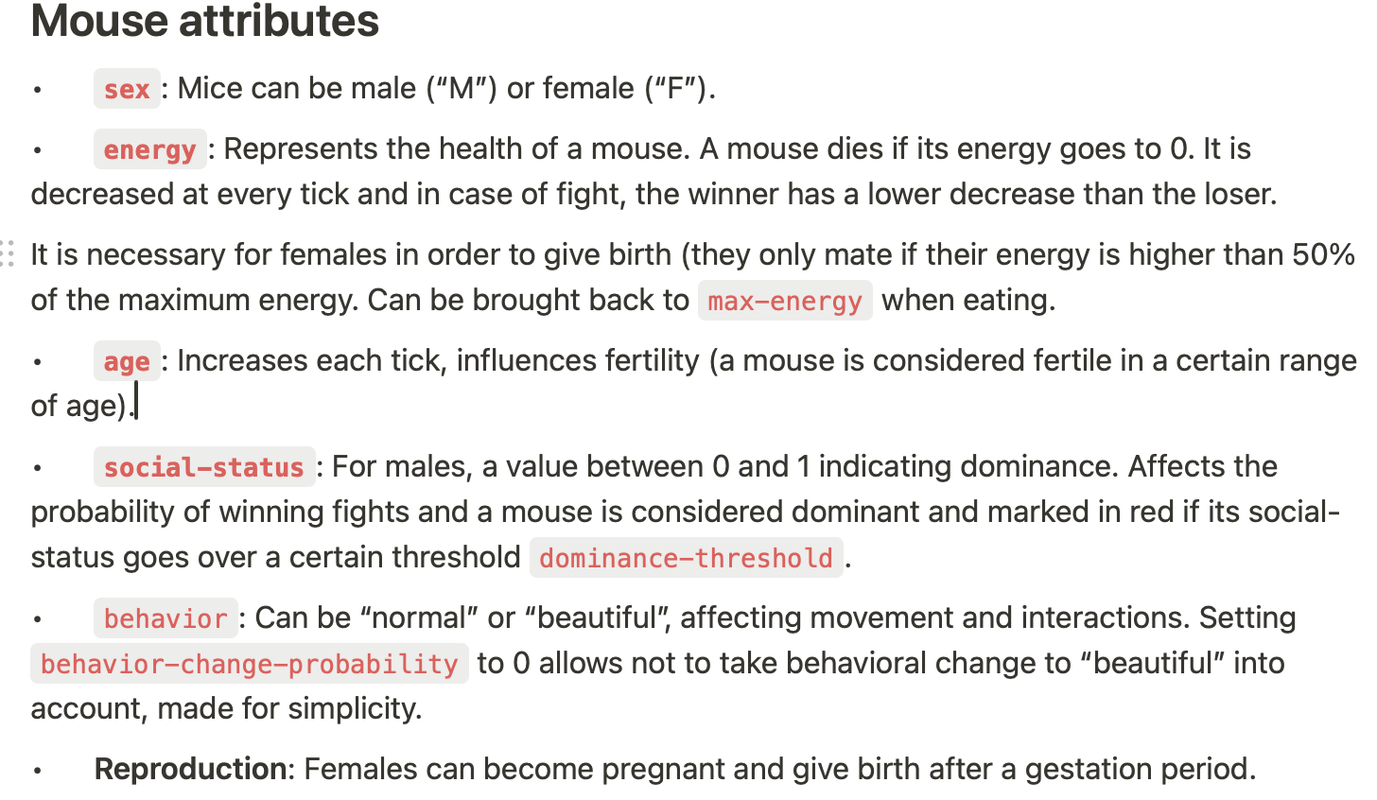
Social dominance and fights – Mouse attributes
Notes:
Mouse attributes
• sex: Mice can be male (“M”) or female (“F”).
• energy: Represents the health of a mouse. A mouse dies if its energy goes to 0. It is decreased at every tick and in case of fight, the winner has a lower decrease than the loser.
It is necessary for females in order to give birth (they only mate if their energy is higher than 50% of the maximum energy. Can be brought back to max-energywhen eating.
• age: Increases each tick, influences fertility (a mouse is considered fertile in a certain range of age).
• social-status: For males, a value between 0 and 1 indicating dominance. Affects the probability of winning fights and a mouse is considered dominant and marked in red if its social-status goes over a certain threshold dominance-threshold.
• behavior: Can be “normal” or “beautiful”, affecting movement and interactions. Setting behavior-change-probability to 0 allows not to take behavioral change to “beautiful” into account, made for simplicity.
• Reproduction: Females can become pregnant and give birth after a gestation period.

Slide 17
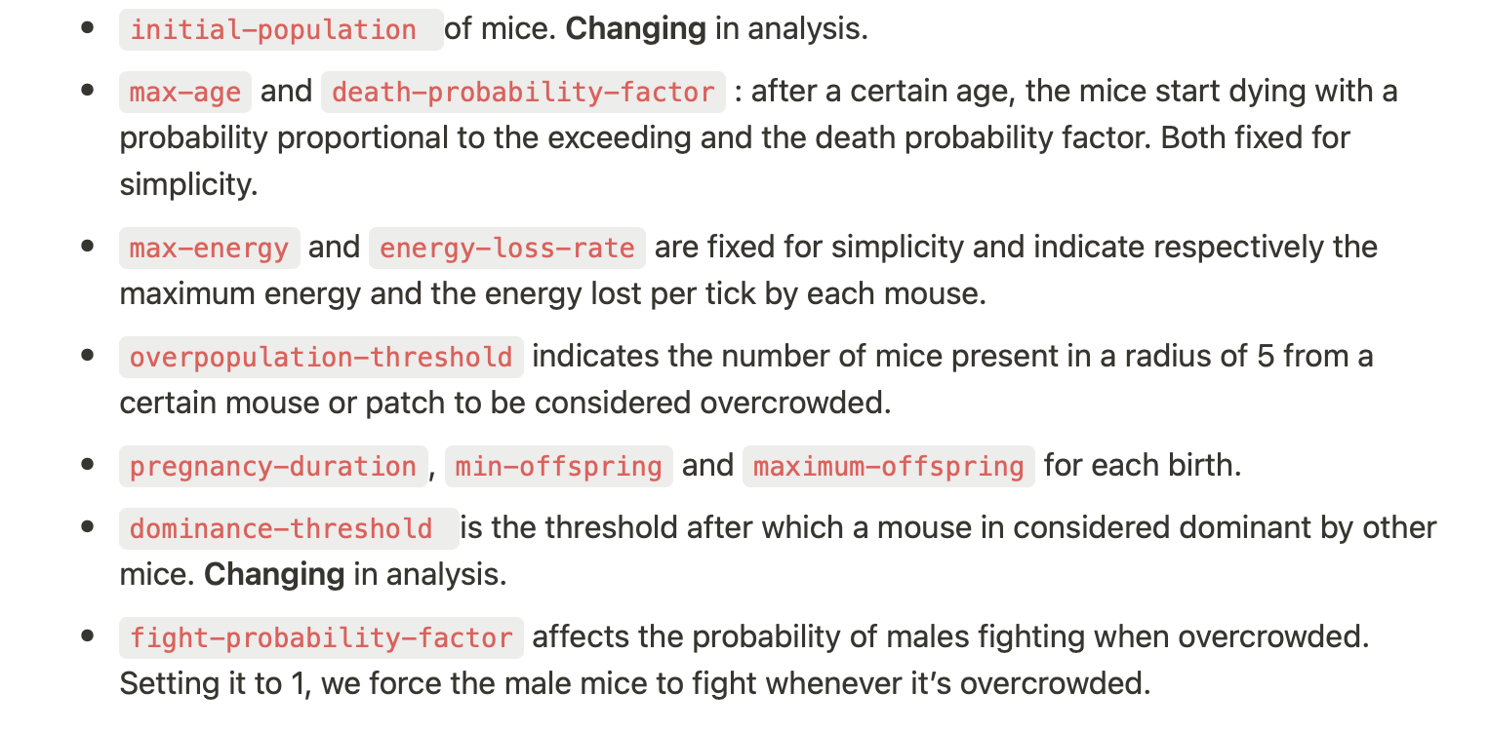
Social dominance and fights – Model parameters
Notes:
MODEL PARAMETERS CHANGING IN ANALYSIS
INIT POPULATION to see how this affects the position of population peaks and the population peak value itslef
MAX AGE to see if longer living span can affect the final result
DOMINANCE-THRESHOLD a threshold after which a mouse is considered dominant

Slide 18

Social dominance and fights
Notes:
The initial configuration allocates the mice randomly on the grid.
Because of the moving dynamics implemented, mice move randomly before they have low energy or before their first meal interval.
In that moment, they expectedly tend to cluster around food-dispenser.
LEGENDA
RUN
LOOK AT the way dominant non-dominant males and females distributes between the four food-dispenser.
In the early phase of most simulations, the distribution is quite random, until some dominant-males emerge. When that happens, we can see a migration of less-dominant mice to less-populated food-dispenser, while the females tend to stick in the vicinity of their food-dispenser.
This causes some food-dispenser to have a low number of dominant-males while still having a large number of females, while in the food-dispenser with less-dominant males, the ratio females over total mice is lower. This dynamics causes the food-dispenser where the dominant mice are, to be more prone to mate, increasing the population around a number related to the initial parameters.

Slide 19
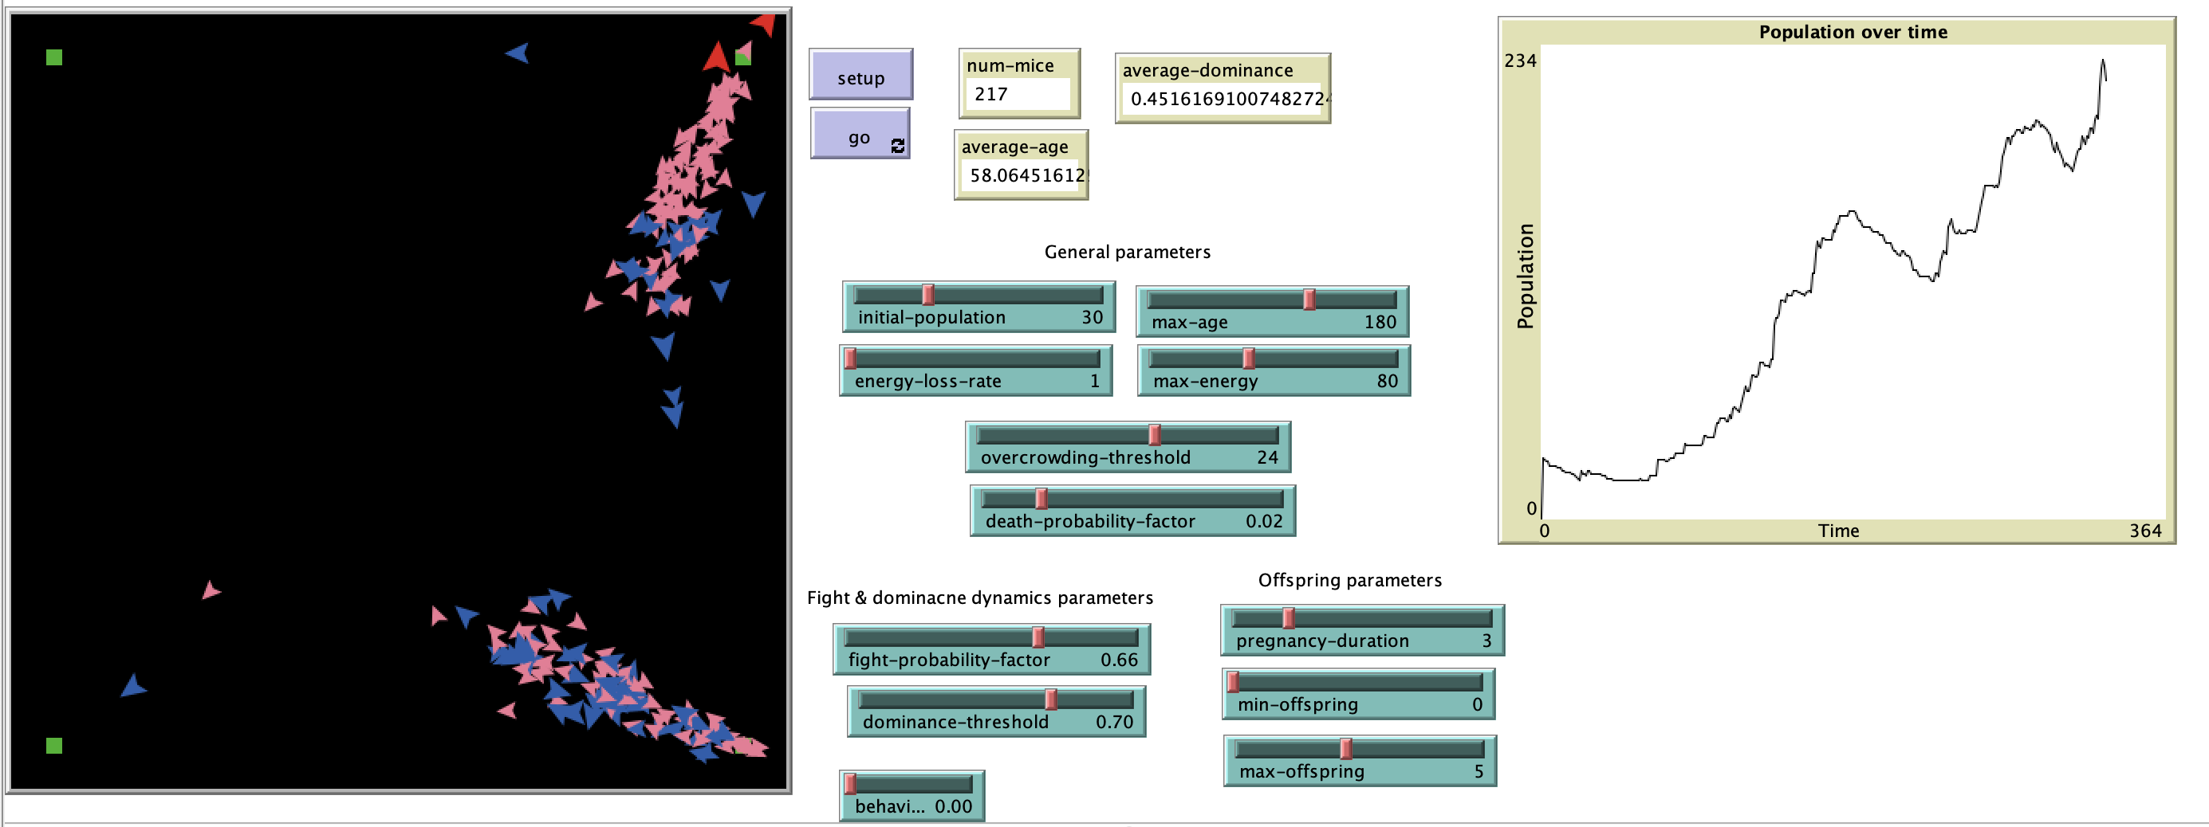
Social dominance and fights – Clustering
Notes:
POPULATION INCREASING, MICE CLUSTERING IN THE DESCRIBED WAY WITH THESE PARAMETERS.

Slide 20
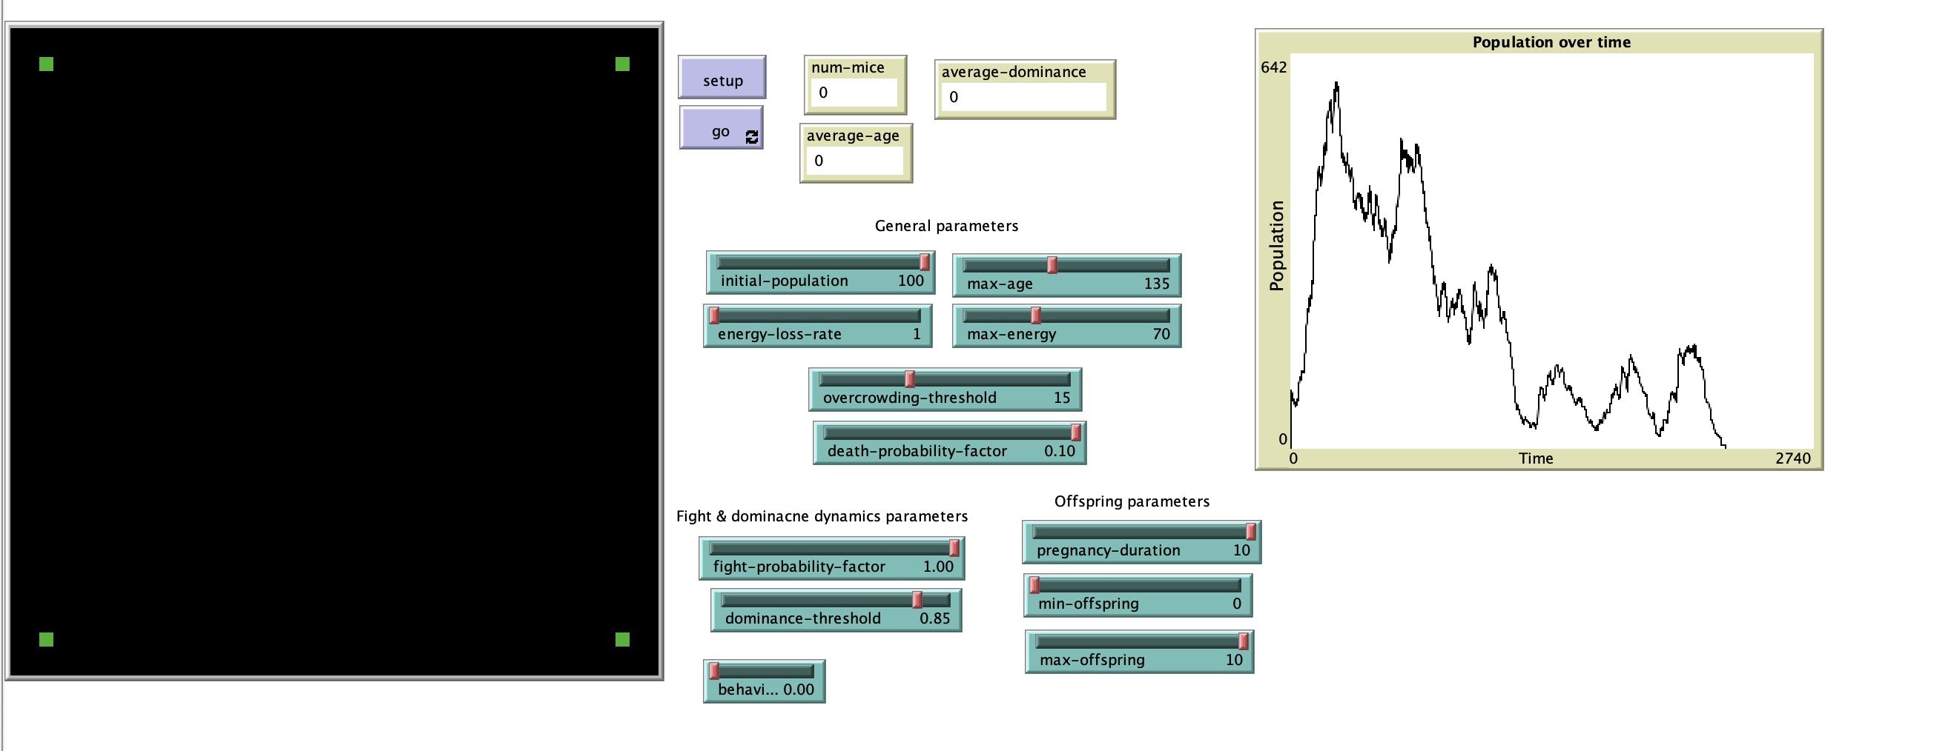
Social dominance and fights – 100 initial population
Notes:
HOW THE INIT POP AFFECTS THE POSITION OF THE PEAK
The population peaks usually happens in the early phases of the simulation with a large number of mice, while happens randomly before extinction with a lower number of mice.
In the following, we FIXED the others parameters to reasonable values to see how initial population affects the peak population.
With the following parameters
initial-population: 100, peak population ranging from 380 to 650.

Slide 21
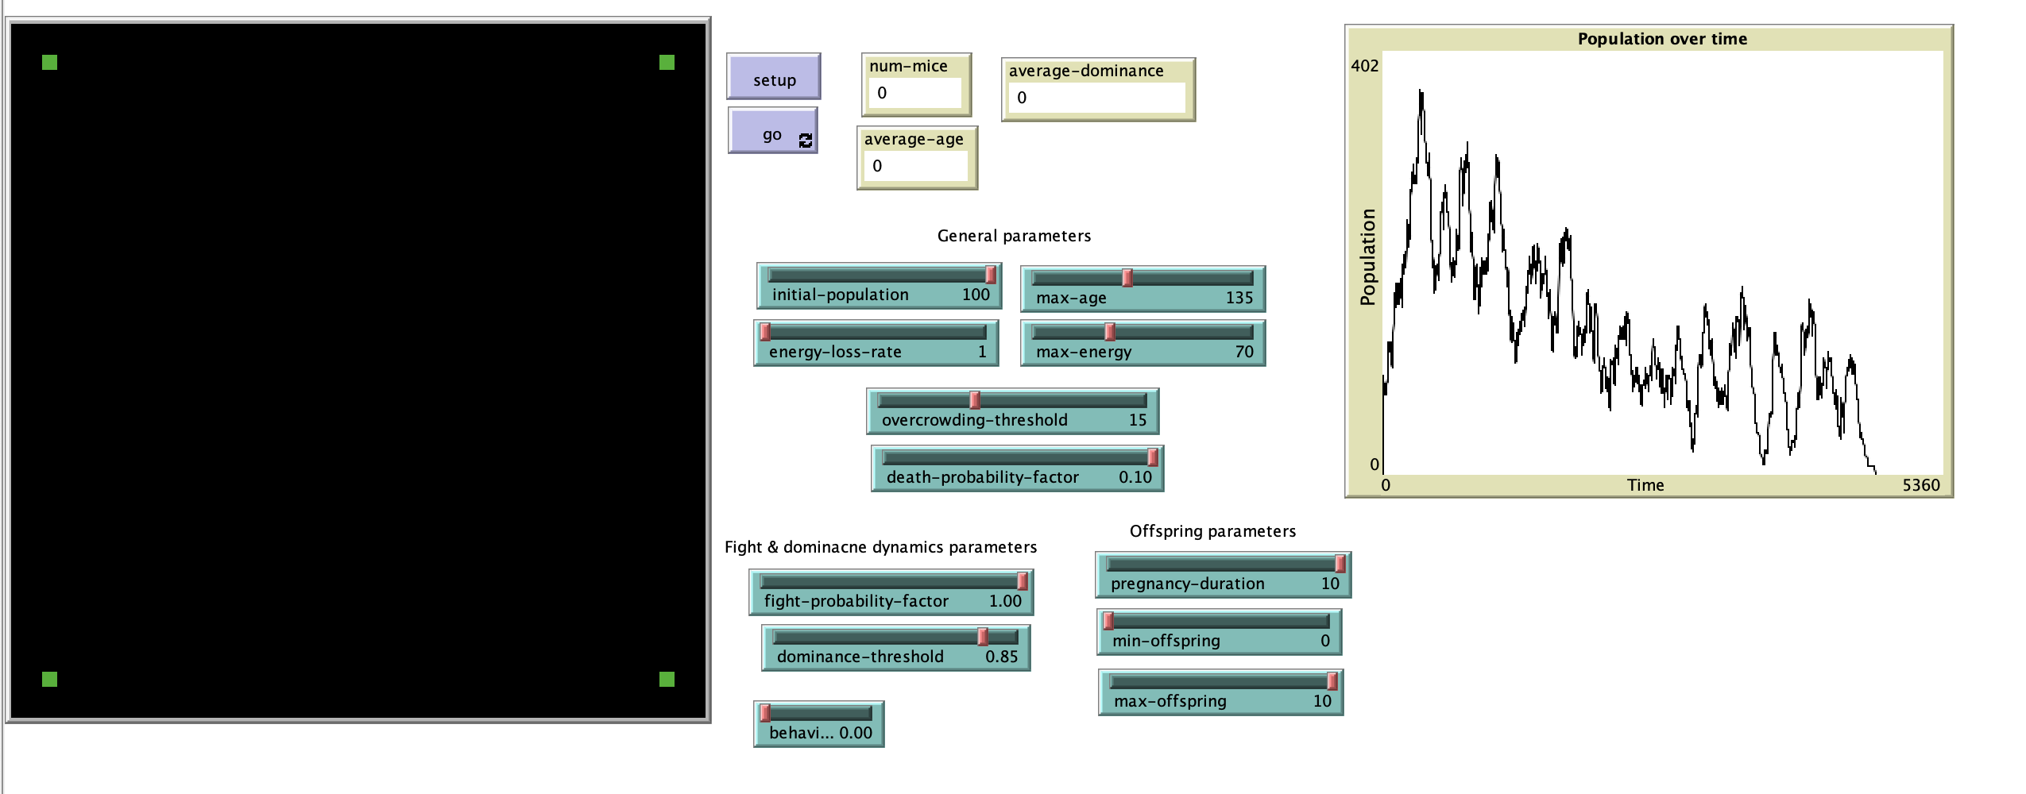
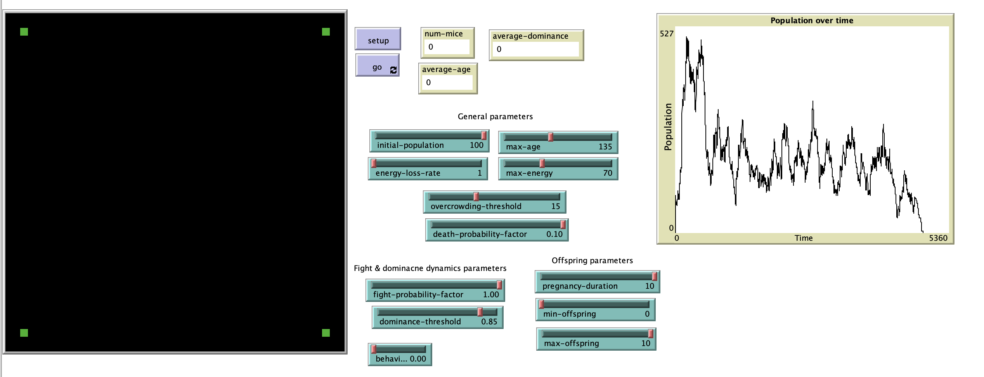
Social dominance and fights – 100 initial population
Notes:
HOW THE INIT POP AFFECTS THE POSITION OF THE PEAK
The population peaks usually happens in the early phases of the simulation with a large number of mice, while happens randomly before extinction with a lower number of mice.
In the following, we FIXED the others parameters to reasonable values to see how initial population affects the peak population.
With the following parameters
initial-population: 100, peak population ranging from 380 to 650.

Slide 22
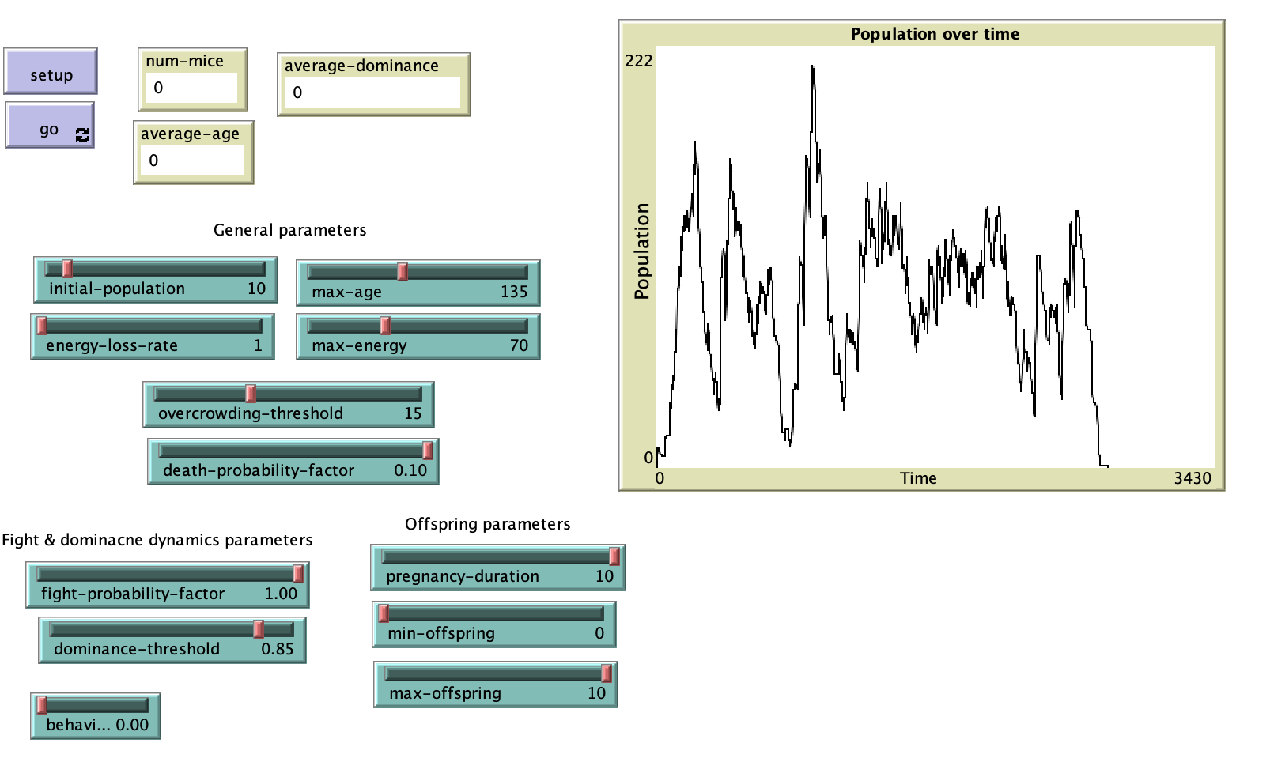
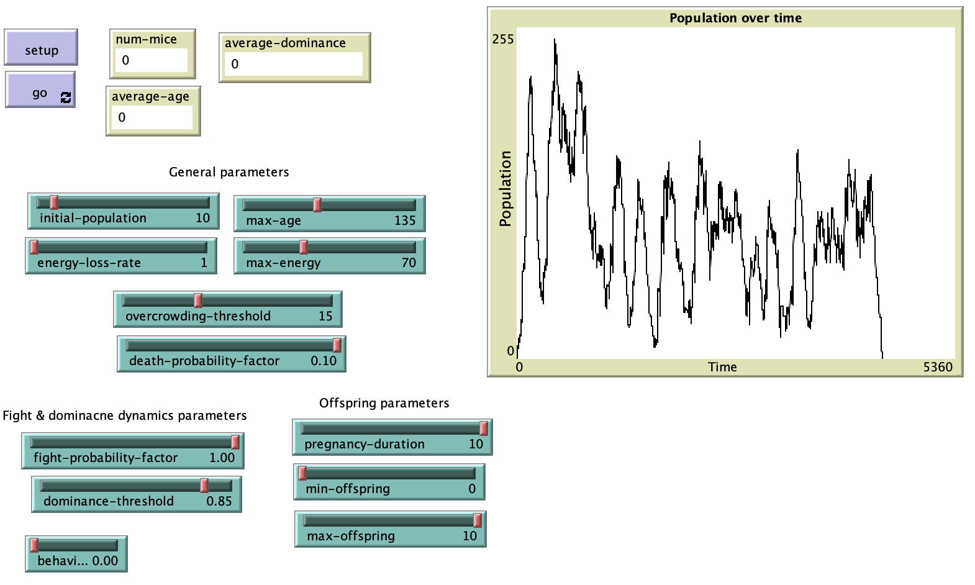
Social dominance and fights – 10 initial population
Notes:
initial-population: 10, ranges 220 to 330.

Slide 23
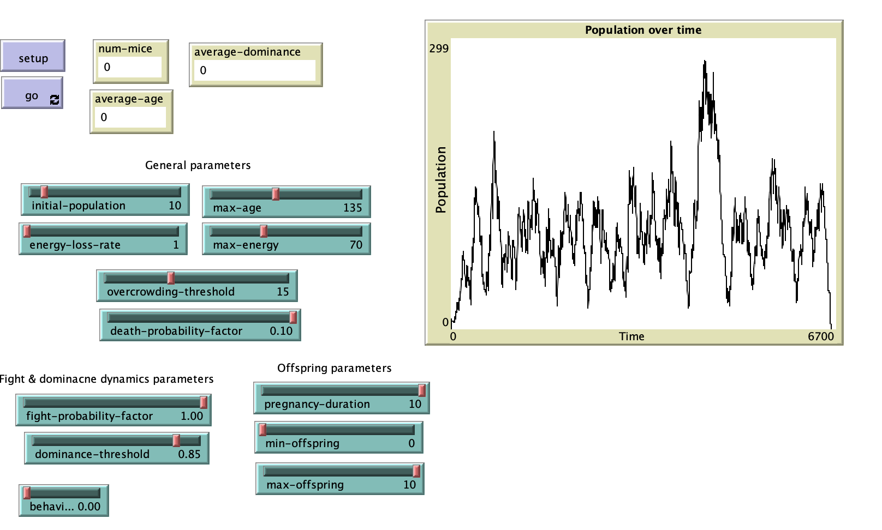
Social dominance and fights – 10 initial population
Notes:
initial-population: 10, ranges 220 to 330 AND PEAK IS LATER
Even setting the range of offspring per birth from 0 to 10, it is possible to see how over a variable number of ticks and oscillations in the total population values, in all the simulations with these parameters the population eventually goes towards extinction.

Slide 24
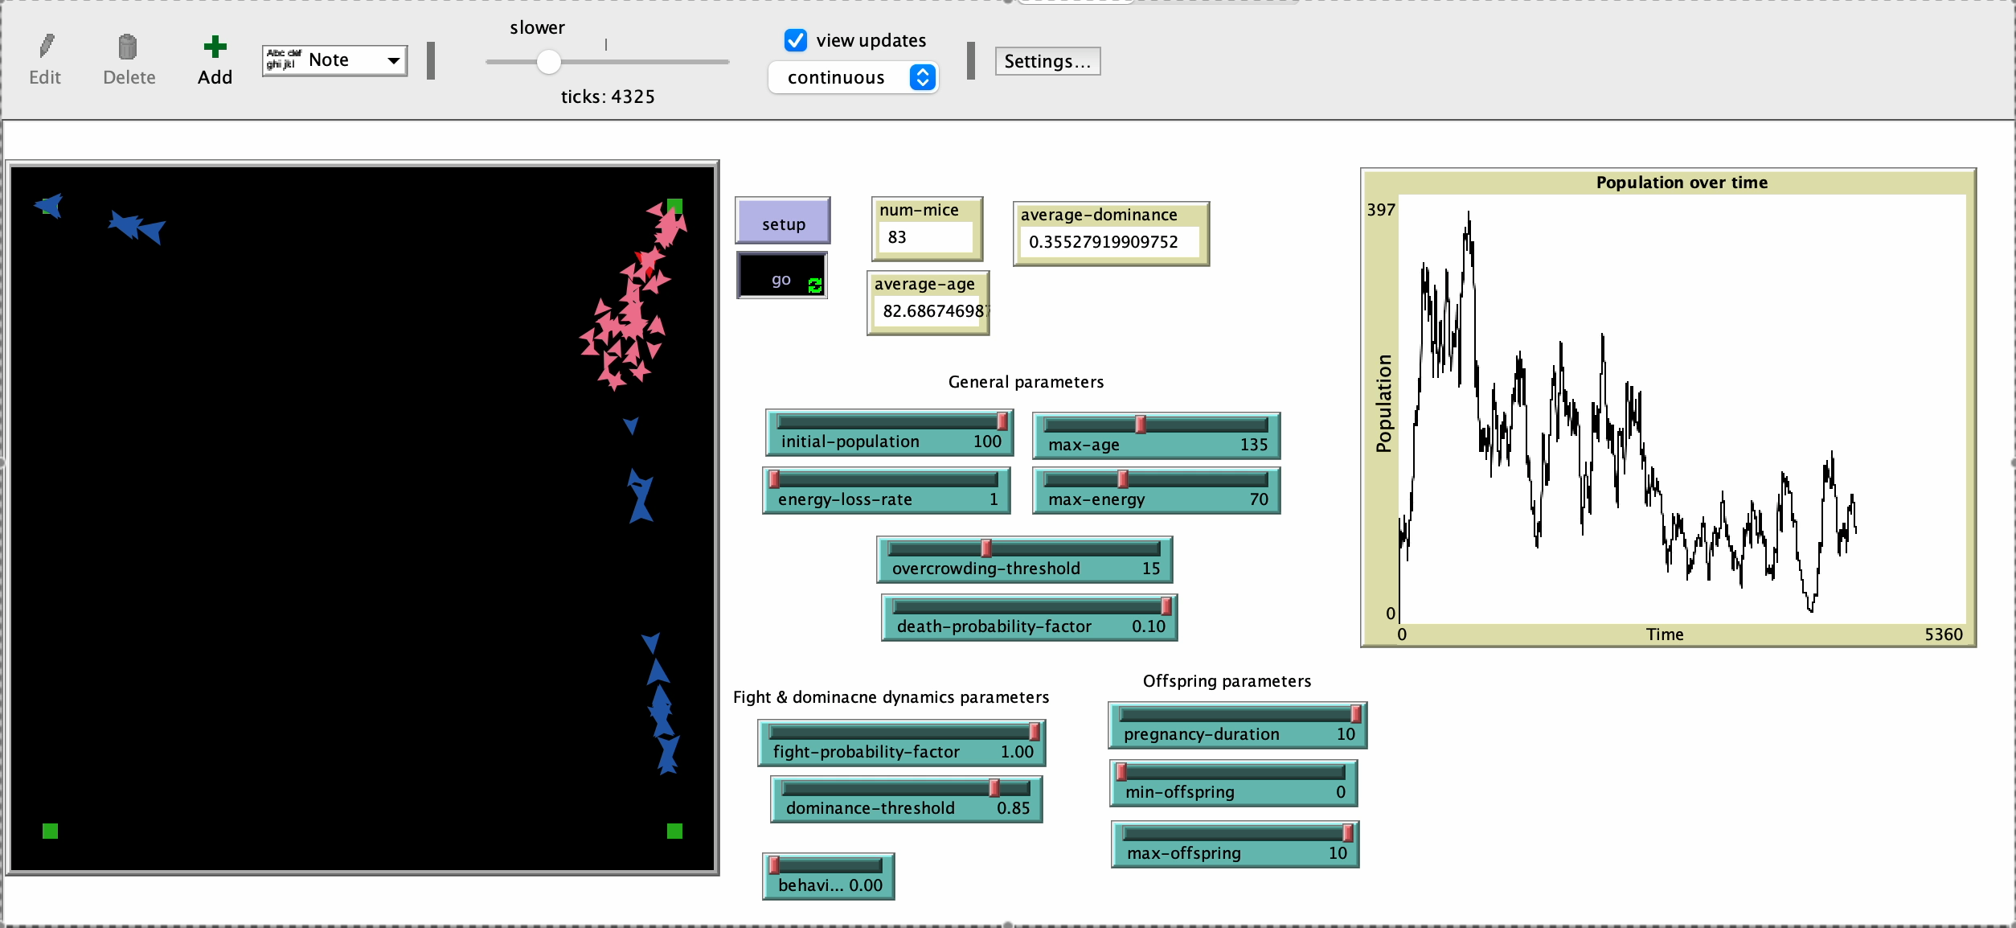
Social dominance and fights – Why extinction?
Notes:
Extinction happens to be a degenerate result of one of the negative peaks of the oscillations OF POPULATION.
WHAT HAPPENS IS THAT WHEN THE MICE CLUSTER AROUND FOOD DISPENSER, THE OVERCROWDING IN THAT AREAS LEADS THE MICE TO START FIGHTING AND THE BIRTHS TO DECREASE
THIS LEADS TO OSCILLATIONS
WHEN THE OVERCRWODING THRESHOLD IS NOT SATISFIED ANYMORE, THE RATS START AGAIN TO GROW
BUT WHAT LEADS TO EXCTINCTION? LET’S DELVE INTO THAT
AFTER
Most of the times, as in the video present here it happens when a dominant male dies and leaves a big number of females close to a food dispenser. Among the remaining less-dominant males, sparsely distributed in the other dispensers, none can establish a new position of dominance to create another cluster of dominant mouse and females that could make the population grow again.
Using other dominance-threshold parameters, the situation stays the same, resulting in extinction for the same reason, but in less ticks.

Slide 25
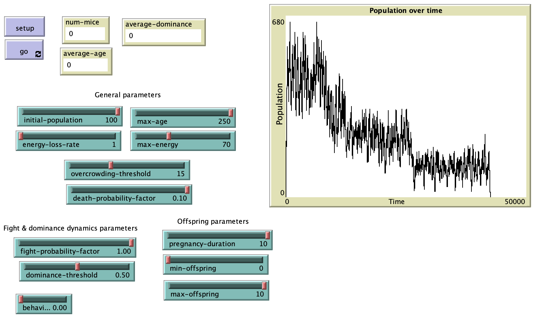
Social dominance and fights – Changing max-age
Notes:
VARYING MAX AGE
maximum-age: by varying the maximum age, the results are approximately the same, but the times are dilated and the peak is slightly higher, as one would expect. Similar result was seen while seen varying death-probability-factor.
This suggests that the main reason for extinction is not the aging population, but the number of fights and the establishment of social dominance.
With a higher max-age, we can only see how the total population is oscillating less randomly in a longer timeframe, and it’s possible to see the trend of the overall decreasing peaks.

Slide 26
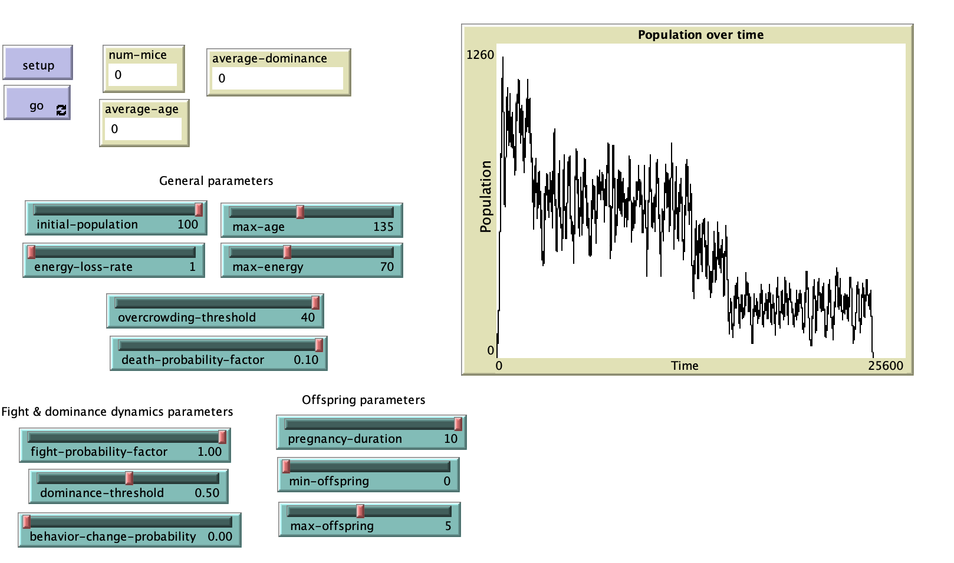
Social dominance and fights – Changing Overcrowding Threshold
Notes:
The parameter that affects the most the simulation results is overpopulation-threshold.
It affects the probability of reproducing and is the threshold after which the mice start fighting.
Fixing all the other parameters as before (except for maximum-offspring, reduced to 5 for computational reasons) and running the simulation with an over-population-threshold of 40. We obtain the following result:
Even if the population peak expectedly reaches a significantly higher values than before, the overall trend is the same and mice extinct after 23,000 ticks.

Slide 27
3. Infant Mortality and Mothership
Speaker: Francesco Rosano

Slide 28
«… An even greater number (of females - editor’s note), after successfully giving birth, fell short in their maternal functions.
... stress from social interaction led to such disruption of maternal behavior that few young survived.
Population Density and Social Pathology,
John B. Calhoun
https://gwern.net/doc/sociology/1962-calhoun.pdf

Slide 29
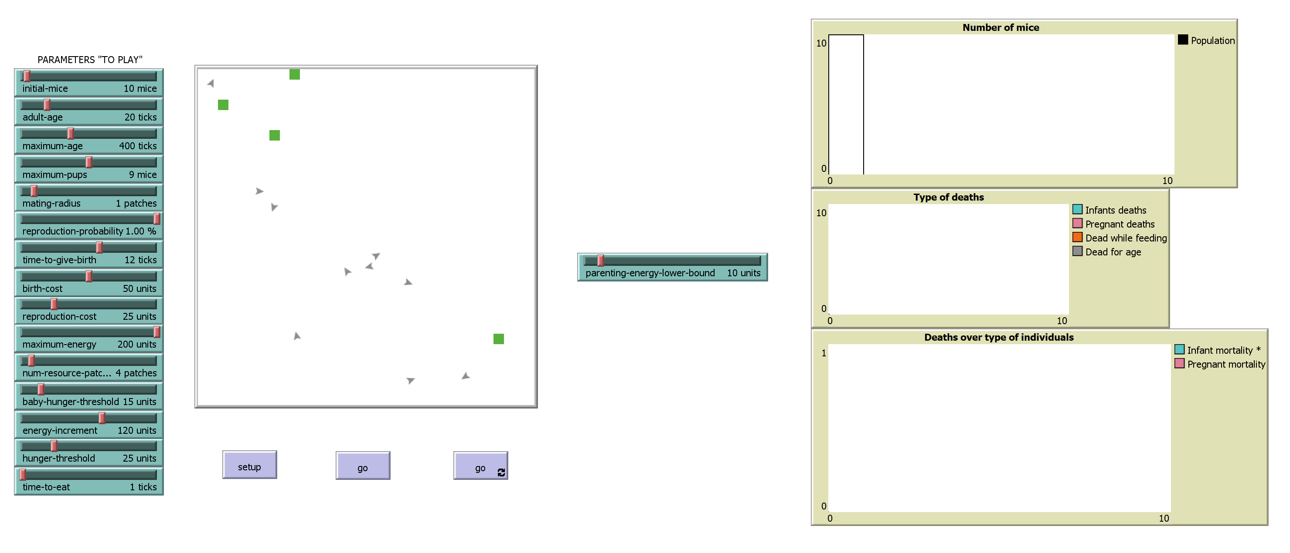
Infant Mortality and Mothership
MODEL RULES:
Finite number of infinite energy sources
Agents move randomly until when they need resources, then towards sources
Time to eat proportional to the number of agents in the radius of the source
Only «adult» mice get pregnant (coupling with another mouse)
Pregnancy takes time
«Young» mice can get fed only by their parents
Notes:
MODEL RULES

Slide 30
Infant Mortality and Mothership
MODEL SETTING:
MAIN PARAMETER
Notes:
MAIN PARAMETER, SELFISHNESS and ALTRUISM

Slide 31
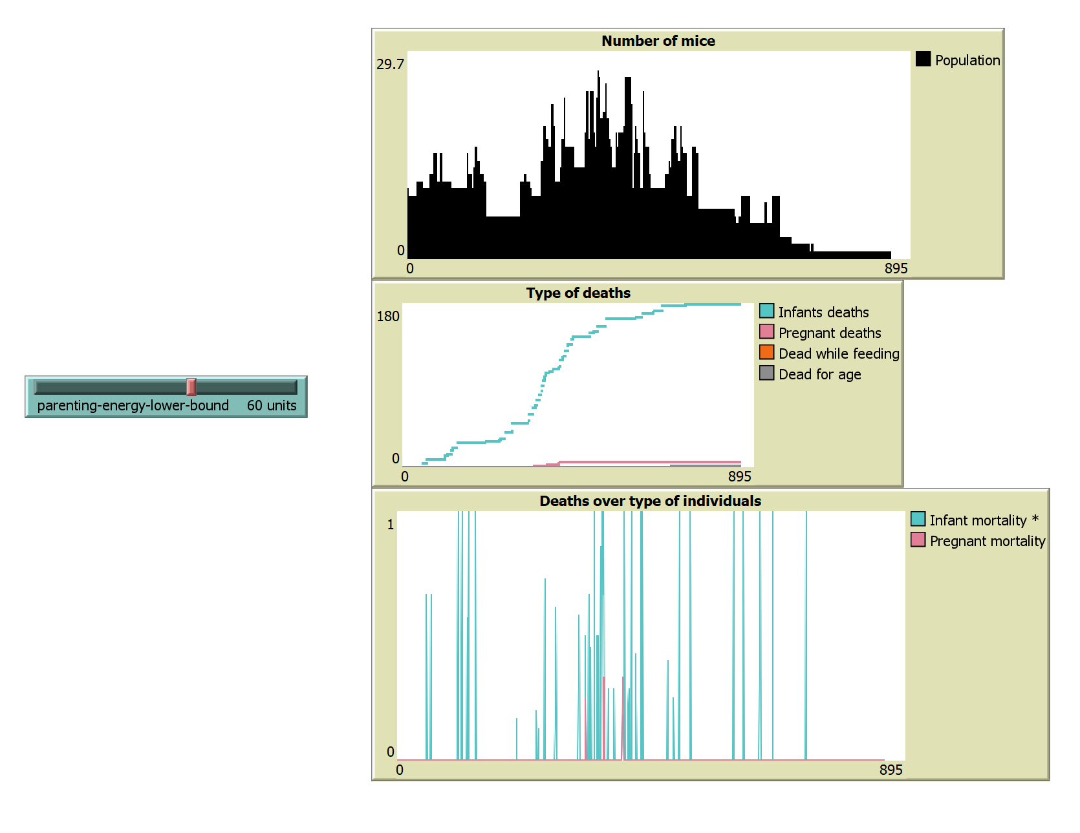
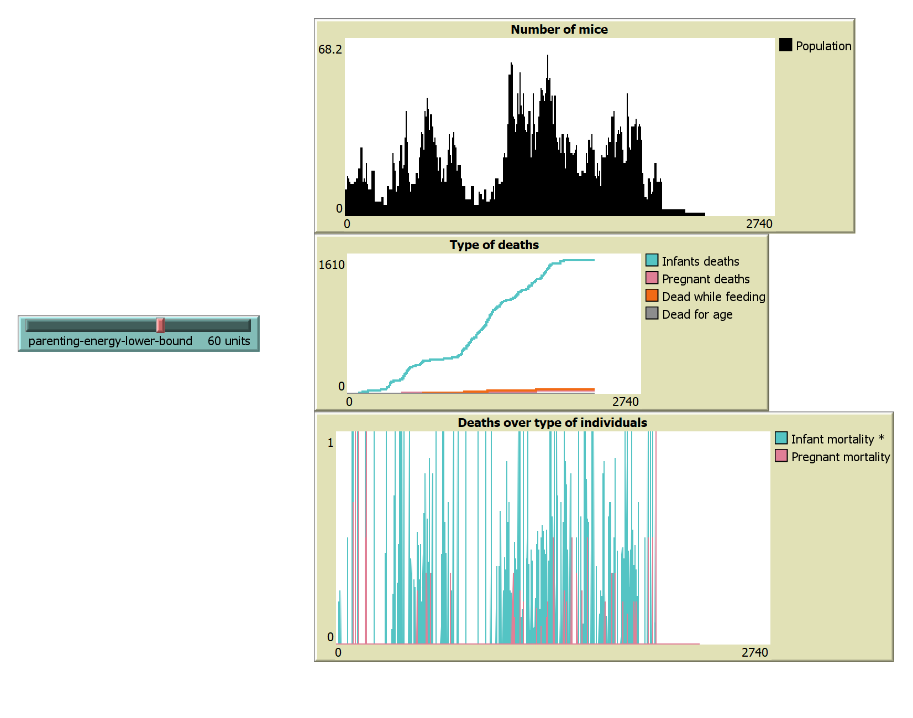
Infant Mortality and Mothership
LOW «MOTHERSHIP» EXTINCTION
VERY LOW PEAKS OF POPULATION
CORRELATION BETWEEN POPULATION PEAKS AND INFANT MORTALITY
Notes:
LOW POPULATION PEAK, HIGH INFANT MORTALITY CORRELATED WITH POPULATION PEAKS

Slide 32
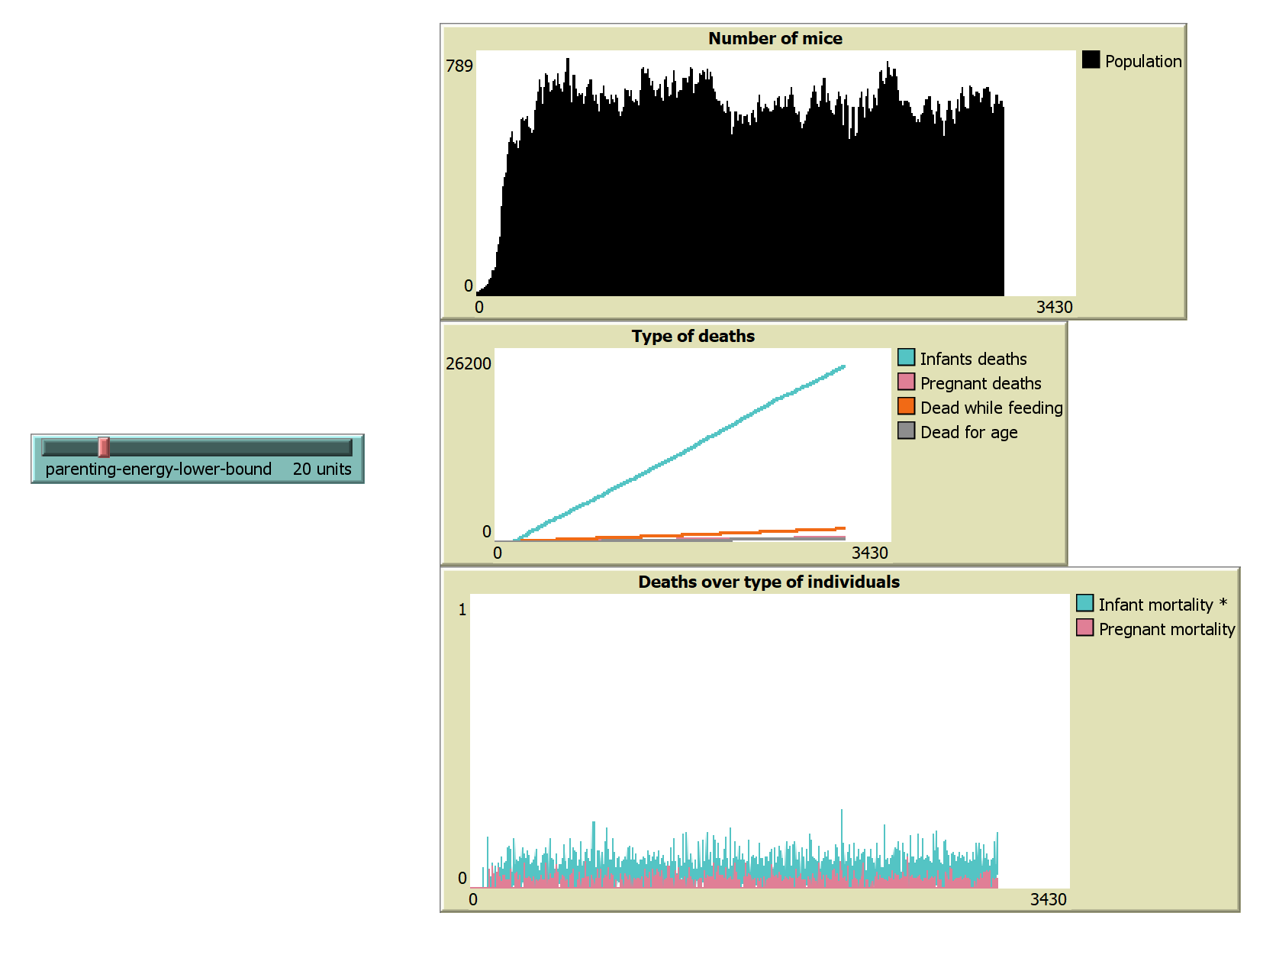
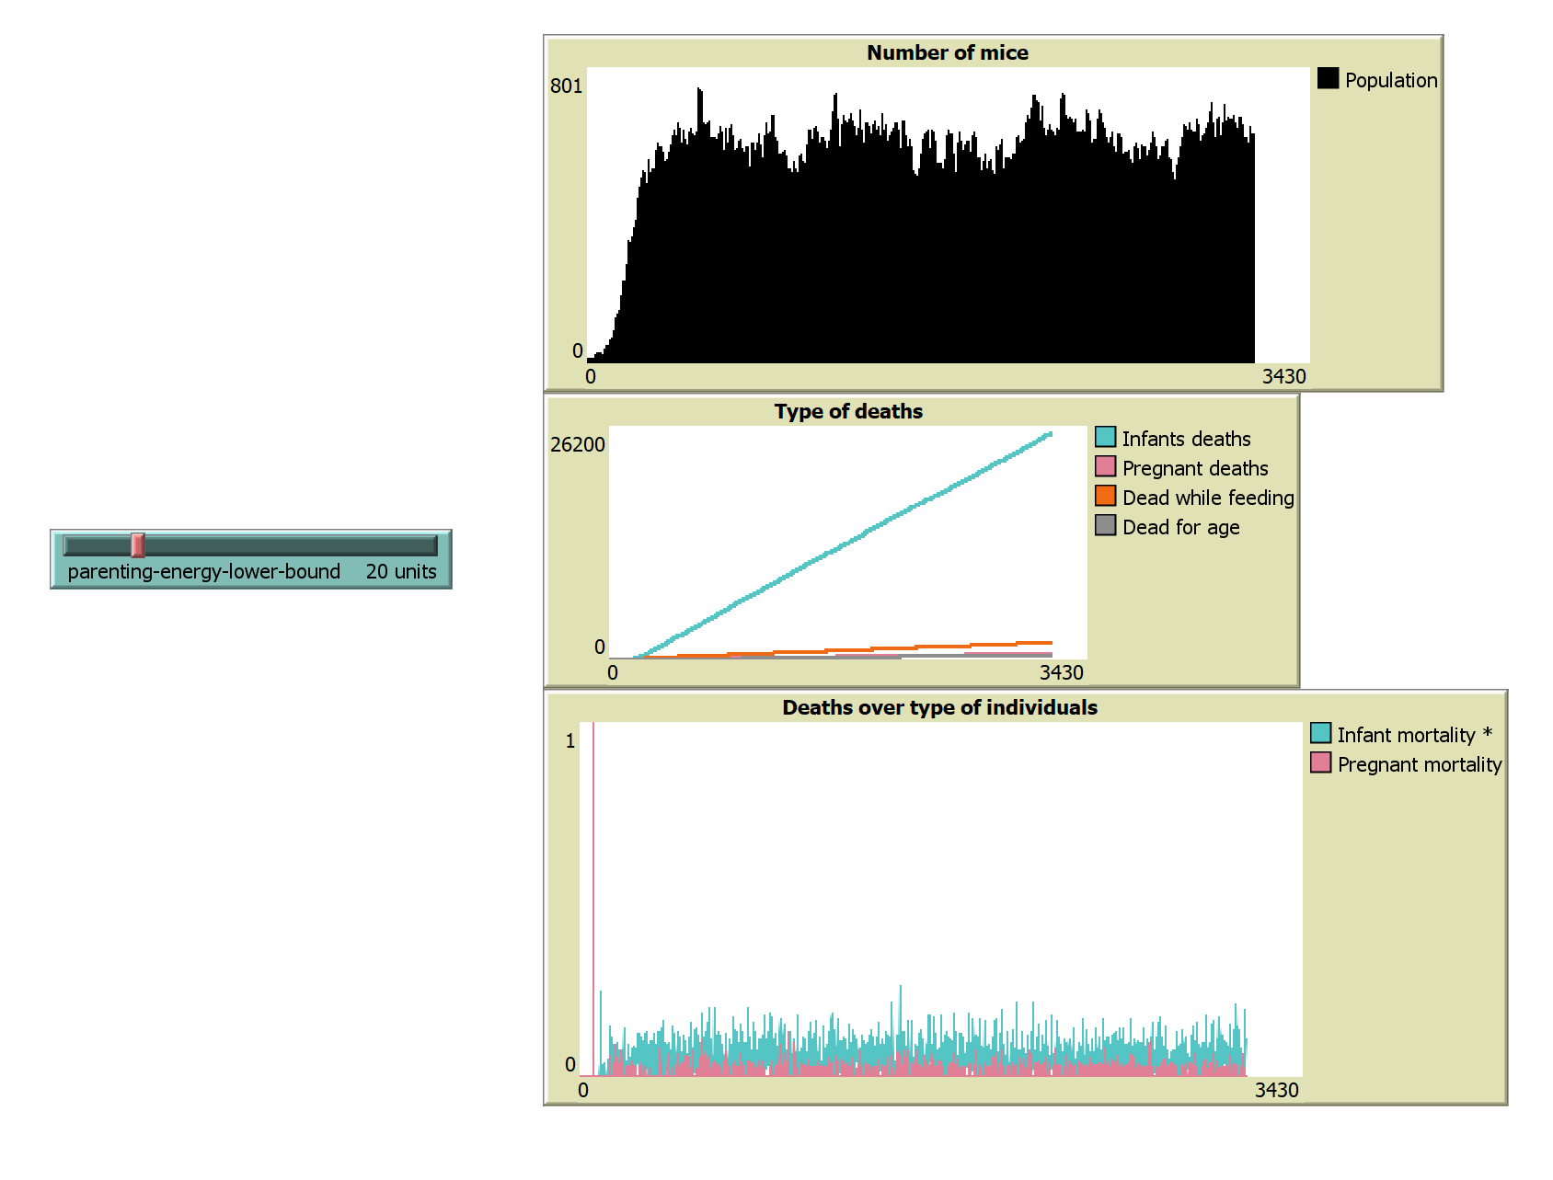
Infant Mortality and Mothership
HIGH «MOTHERSHIP» STABILITY
AVERAGE POPULATION IS WAY HIGHER
INFANT MORTALITY IS STABLE, AND OVERALL LOWER
Notes:
HIGHER PEAK, POPULATION DOES NOT COLLAPSE, INFANT MORTALITY OVERALL LOWER AND CONSTANT
TRANSITION BETWEEN THIS AND PREVIOUS MAY HAVE BEEN A GREAT FACTOR IN THE EXTINCTION
MODELS MAY HAVE BEEN BIASED FROM ASSUMPTIONS BUT STILL PLAYABLE, EVEN THOUGH INFERING REALITY FROM THOSE IS HARD. ANY SUGGESTION?

Slide 33
Thank you for your attention!
A. Melone, H. Ranieri, F. Rosano

